Slide 1
Funding Strategies for Social Scientists at Hispanic-Serving Institutions

Slide 2
Welcome!
Quick Poll for Breakout Rooms:
Around what research topic(s) would you like to connect with other attendees?
Please type 1-3 keywords into Chat box - E.g.,
research methods, participatory research, migration
Notes:
Also - note about recording and annonymizing self - pose questions in chat box if you don’t want to appear in the video and audio recording.

Slide 3
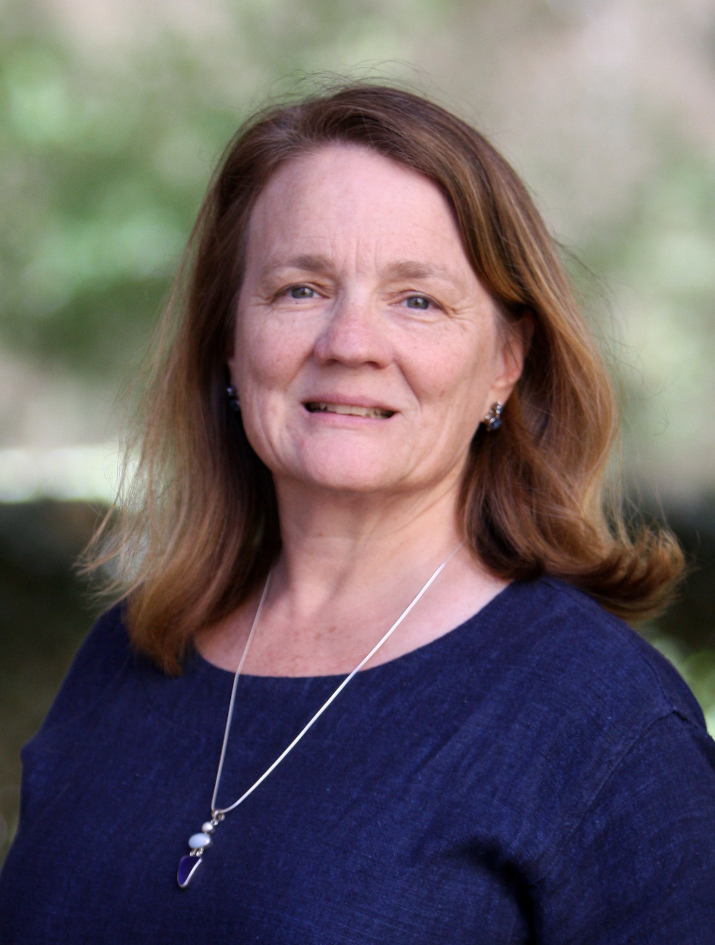
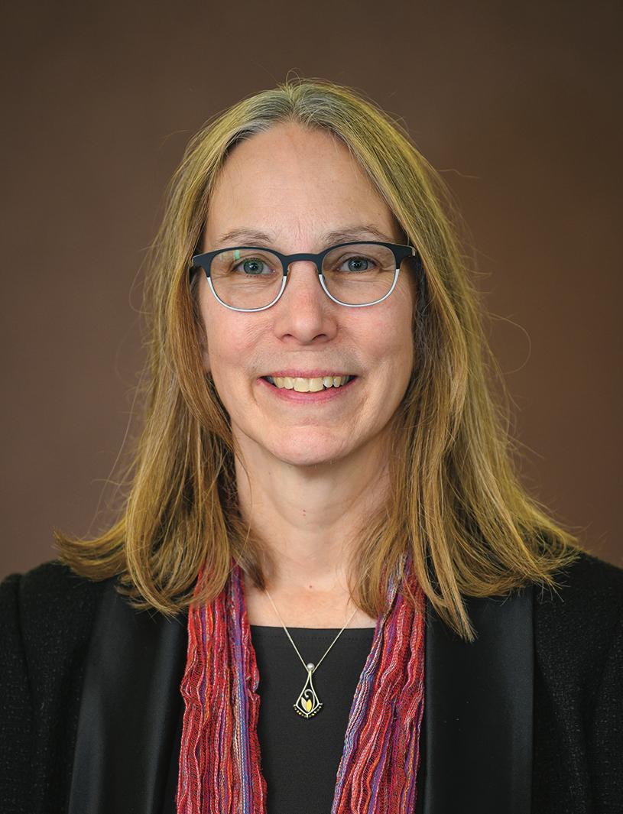
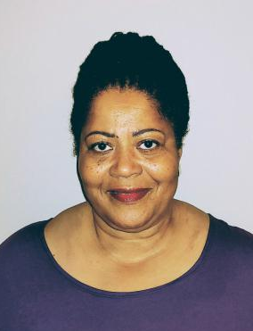
About Us
DR. HOLLY HAPKE, UCI
DR. WENDA BAUCHSPIES, NSF
DR. SHARON TETTEGAH, UCSB

Slide 4
Housekeeping
Faculty Research Survey – please help us!
https://csuci.qualtrics.com/jfe/form/SV_a5KFY1RWSTJLZK6
Webinar feedback evaluation (3 questions) – at conclusion of today
Recording session

Slide 5
Overview and Objectives:
How to find funding for your research - General tips
Guest Presentation
Overview of NSF for social, behavioral and economic scientists
How to find funding
Is NSF funding for you?
Demystifying the Review Process
How it works
Why proposals get declined
Networking Time
Wrap-Up

Slide 6
Funding Strategies Who Funds Social Science Research?
Foundations (Not exhaustive)
William T. Grant Foundation
Russell Sage Foundation
Carnegie Corporation of NY
Social Science Research Council
John Randolph and Dora Haynes Foundation
American Council of Learned Societies
Alfred P. Sloan Foundation
The Spencer Foundation
Ford Foundation
Wenner Gren Foundation
Henry Luce Foundation
John D. and Catherine T. MacArthur Foundation
Federal Agencies (Not exhaustive)
National Science Foundation
National Institutes of Health
National Endowment for the Humanities
US Department of Agriculture
US Department of Commerce
US Department of Defense
US Department of Education
US Department of Energy
US Department of Health & Human Services
US Department of Housing & Urban Development
US Department of the Interior
US Department of Justice
US Department of Labor
US Department of State
US Department of Transportation
US Department of Treasury
US Department of Veteran’s Affairs
Environmental Protection Agency
Notes:
mention research development and Foundations relations personnel - campus specific, but here’s what you should explore

Slide 7
Funding Strategies
Types of Funding Available
Fellowships, Grants
Research, Training, Workshops, Research Collaborations, Travel
How to Find Funding
Grants.gov
Philanthropy News Digest - https://philanthropynewsdigest.org
Campus Subscription
PIVOT
SPIN
Grants Resource Center (CSU)
Strategies for Successful Funding
Proposal writing is a genre of writing
Present a compelling problem with sound, realistic plan for completion
Align proposed project with agency’s mission
Address all components of call for proposals; follow all guidelines for formatting, style and information
Important Things to Know:
Institutional Procedures – work with appropriate university staff to submit grant and fellowship applications
Research Development support services – at all UC’s; at some CSU’s

Slide 8
An Introduction to and Overview of NSF

Slide 9
Outline
What is NSF’s mission? What type of research does it fund?
How to find funding opportunities at NSF?
How does NSF make proposal funding decisions? And why do proposals get declined?
When and How to Communicate with a Program Officer

Slide 10
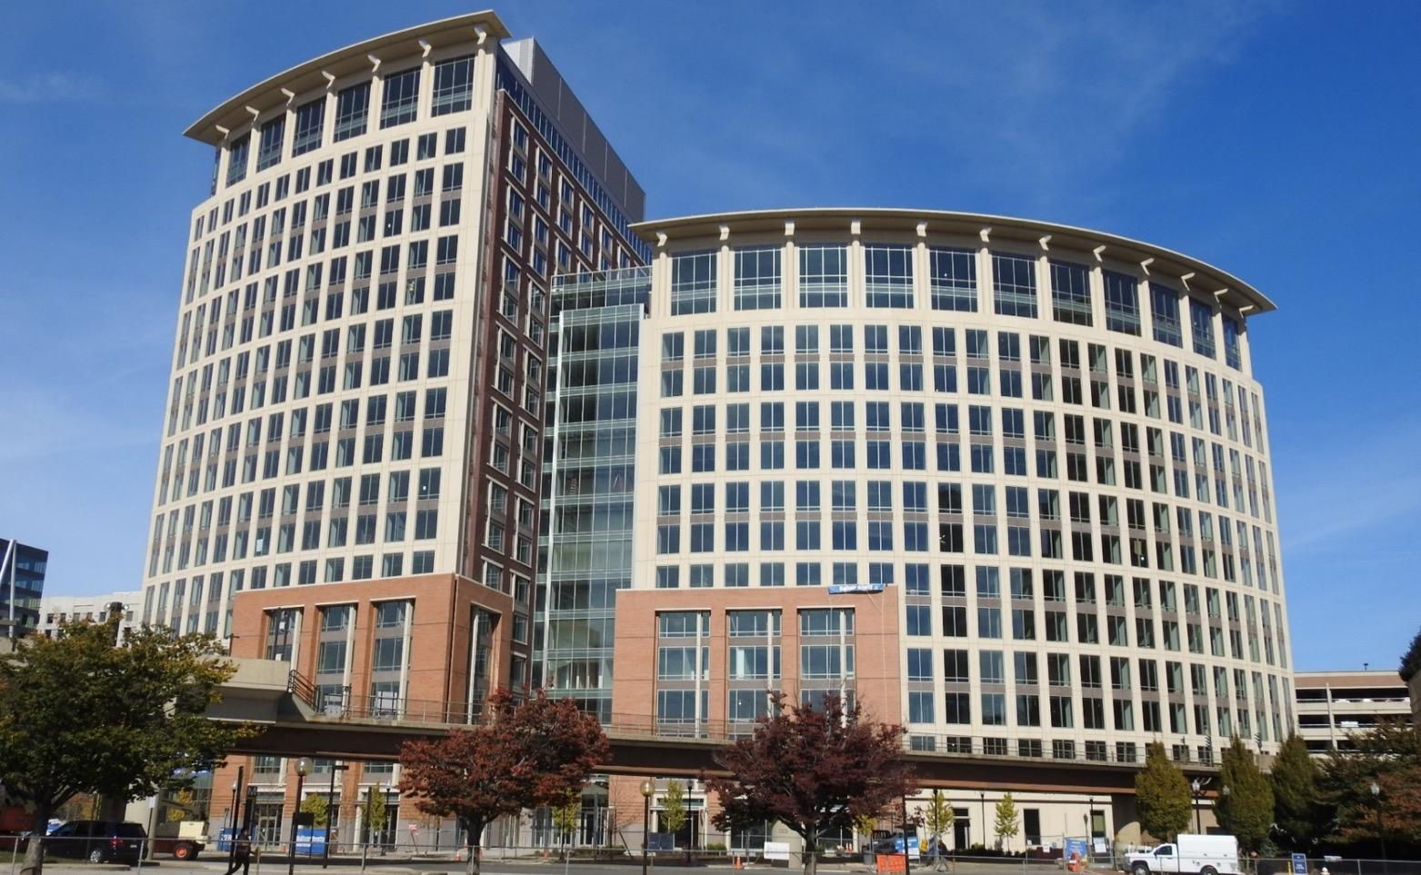
National Science Foundation
Mission: To promote the progress of science; to advance the national health, prosperity, and welfare; to secure the national defense…
Vision: A nation that is the global leader in research and innovation
Notes:
Mission: From the National Science Foundation (NSF) Act of 1950 (P.L. 81–507)
Vision: From “Building the Future: Investing in Discovery and Innovation” NSF’s Strategic Plan for FY 2018–2022
Average Annual budget: b/t ~ $7.0-8.0 billion
~11,000 new awards yearly, average duration of three years
Important to keep this in mind. It is taxpayer supported, despite its name.
Established by Congress in 1950 as an independent federal agency to promote American science and engineering (S&E).
• The only federal agency that funds basic non-biomedical research and education across all fields of S&E and at all levels of education.

Slide 11
NSF Structure
The Director, Office of Budget, Finance, & Award Management, Office of International Science & Engineering, etc.
Directorate for
Geosciences
(GEO)
Directorate for
Biological Sciences (BIO)
Directorate for
Computer & Information Science & Engineering (CISE)
Directorate for
Engineering (ENG)
Directorate for
Education & Human Resources (EHR)
Directorate for
Mathematical & Physical Sciences (MPS)
Directorate for
Social, Behavioral & Economic Sciences (SBE)
Directorates are divided into Divisions or Clusters, and each has several programs. For example:
The Sociology Program (SOC) is in the Division of Social and Economic Sciences (SES), in the Directorate for Social, Behavioral and Economic Sciences (SBE).
The Social Psychology Program (SP) is in the Division of Cognitive and Behavioral Sciences (BCS) in the Directorate for Social, Behavioral, and Economic Sciences (SBE).
- Improving Undergraduate STEM Education (IUSE:EHR) is in the Division of Undergraduate Education (DUE) in the Directorate for Education and Human Resources (EHR)
Notes:
7 research directorates – like colleges at a university
Opportunity to discuss co-review

Slide 12
NSF funds basic science research
Grounded in a broader theoretical framework.
Focuses on one or a few research questions grounded in that framework.
Uses scientifically sound approaches
Generates broader theoretical knowledge (generalizable knowledge).
Notes:
It is not ‘either’ ‘or’; results from basic science often have great direct and indirect utility and applicability. NSF funds basic science BUT, there needs to be the potential for societal relevance and benefit [people get confused about this]
BSci at its core is first and foremost about generalizable knowledge and broader theoretical dev’t, not the focused application of specific results – to be competitive at NSF theoretical contribution is very important!!
BSci is investigating something fundamental and that contributes to theory building; Applied research is taking something that is already known and applying it to a particular problem; it is usually atheoretical and does not have as an objective theory building.
Analysis and synthesis are favored over prescription – don’t be trying to simply “assess” the impact of something!

Slide 13
This includes:
Ethnographic research and other qualitative methods
Mixed methods research
Research in international contexts
Challenge is to 1) detail methods for data collection AND analysis; 2) emphasize the general theoretical understanding that will emerge; and 3) explain why a specific case study is appropriate for investigating the general theoretical questions posed

Slide 14
Types of Proposals & Awards
Research: “Regular” or Standard Research, New Investigators (CAREER; DDRIG), Mid-Career Advancement (MCA), High Risk Awards (RAPID, EAGER)
Research Community Building: Workshop, Conference, & Research Coordination Networks (RCNs)
Training: Graduate Research Fellowships, Post-doctoral Fellowships, Research Experiences for Undergraduates (REU), International Research Experiences for Students (IRES), Research Traineeship (NRT)
Notes:
Point to make - one may apply for any of these - except CAREER which is only for pre-tenure faculty. Early career faculty may apply for any, not just CAREER. What advice should we give about what type of grant one should apply for? (e.g., a new faculty member probably shouldn’t go for a large cross-directorate grant unless part of a team…)
Hierarchy isn’t so much in which type of proposal but in which role you play in a proposal.

Slide 15
Types of Programs and Initiatives
Core Programs - Disciplinary-based
Cross-Directorate (interdisciplinary) Programs, e.g.:
Innovations at the Nexus of Food-Energy-Water (INFEWS)
Smart & Connected Communities (SCC)
Special Initiatives (announced via Dear Colleague Letters):
Science of Broadening Participation
COVID RAPID funding
International Initiatives:
SBE-RCUK Agreement (now SBE-UKRI)
PIRE
Belmont Forum (e.g., Transdisciplinary Research for Ocean Sustainability)
Notes:
Rotating nature of Pos means that the merit review process – as opposed to personal connections with program officers – drives the award making process.
One of the things that impressed me through the training that we received and through my experience of how we went about recommending awards is the strength of the merit review process and the extent to which it’s considered the gold standard by other agencies in the US and overseas.

Slide 16
Social, Behavioral, and Economic Sciences Directorate (SBE)
Social and Economic Sciences
Behavioral and Cognitive Sciences
SBE Office of Multidisciplinary Activities (SMA)
Economics
Science & Technology Studies
Archaeology and Archaeometry
SBE Research Experiences for Undergraduates Sites
Cognitive Neuroscience
Sociology
Biological Anthropology
Science of Science: Discovery, Communication and Impact
Law & Science
Human-Environment and Geographical Sciences
SBE Science of Broadening Participation
Linguistics/Dynamic Language Infrastructure
Decision, Risk & Management Sciences
Social Psychology
SBE Postdoctoral Research Fellowship
Secure & Trustworthy Cyber Space
Science of Learning & Augmented Intelligence
Security & Preparedness
Cultural Anthropology
Build and Broaden 3.0
Methodology, Measurement & Statistics
Perception, Action, and Cognition
Developmental Sciences
Accountable Institutions & Behavior
Ethics and Responsible Research

Slide 17
Education and Human Resources Directorate (EHR)
Office of the Assistant Director (OAD)
Division of Research on Formal and Informal Settings (DRL)
Division of Graduate Education (DGE)
Division of Undergraduate Education (DUE)
Division of Human Resource Development (HRD)

Slide 18
Advancing STEM Learning through Research
Develop a diverse workforce ready to advance the frontiers of science and engineering for society
Generate new knowledge about STEM learning & education
Grow and sustain a STEM-literate public

Slide 19
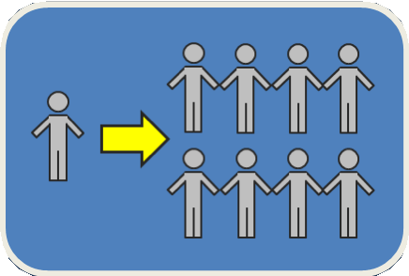
EHR Themes
Learning & Learning Environments
Broadening Participation & Institutional Capacity
Workforce Development

Slide 20
EHR Program Overview
Division | Learning &Learning Environments | Broadening Participation | Workforce Development
Research on Learning (DRL) | S&CC | AISL DR-K12 | ITEST STEM+C CSforALL BCC-EHR*
Undergrad Education (DUE) | IUSE (EHR, GEOPATHS*, RED*, HSI) S-STEM |  | ATE* Noyce AD* C3P* REU-Sites
Graduate Education (DGE) |  |  | SFS/CyberTraining/SaTC GRF / GRIP IGE NRT
Human Resource Development (HRD) | ADVANCE AGEP HBCU-UP TCUP DEL* | LSAMP CREST and RISE REU | PAEMST & PAESMEM CREST

Slide 21
Research and Evaluation in EHR Proposals
All EHR awards should contribute to knowledge about STEM learning and learning environments, workforce development, or broadening participation.
Research
Is integral to the project
Contributes to generalizable knowledge
Includes appropriate methods, depending on the research questions (qualitative, quantitative, or mixed methods)
Evaluation
Projects have a way to assess process or outcomes
Identifies an independent, external evaluator, depending on program solicitation requirements

Slide 22
EHR - Common Guidelines
Foundational Research and Early-Stage or Exploratory Research
Design and Development Research
Efficacy Research
Effectiveness Research
Scale-up Research
https://www.nsf.gov/pubs/2013/nsf13126/nsf13126.pdf

Slide 23
How to Find Funding
Search NSF.gov - https://www.nsf.gov/
“Research Areas”
“Funding”
Key word search
Browse A-Z index by title
Browse by Research Area, Special Program
Upcoming Due Dates
Recent Funding
Other
“Awards”
Sign up for alerts - https://service.govdelivery.com/accounts/USNSF/subscriber/new

Slide 24
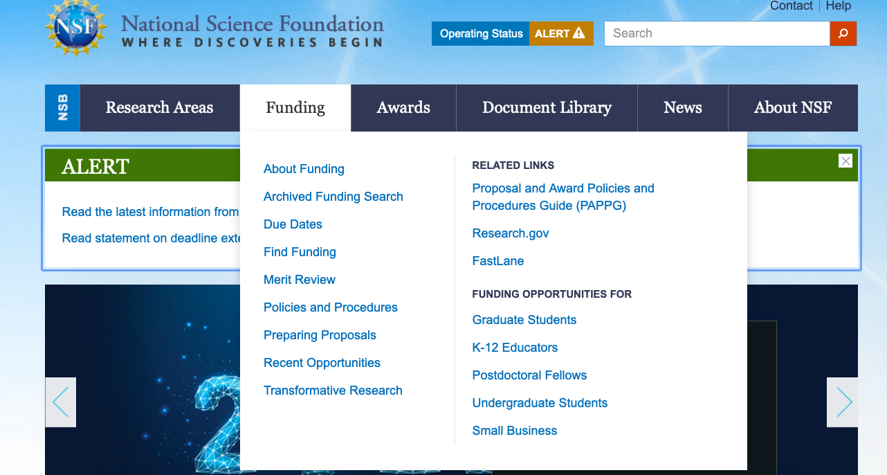
https://www.NSF.gov

Slide 25
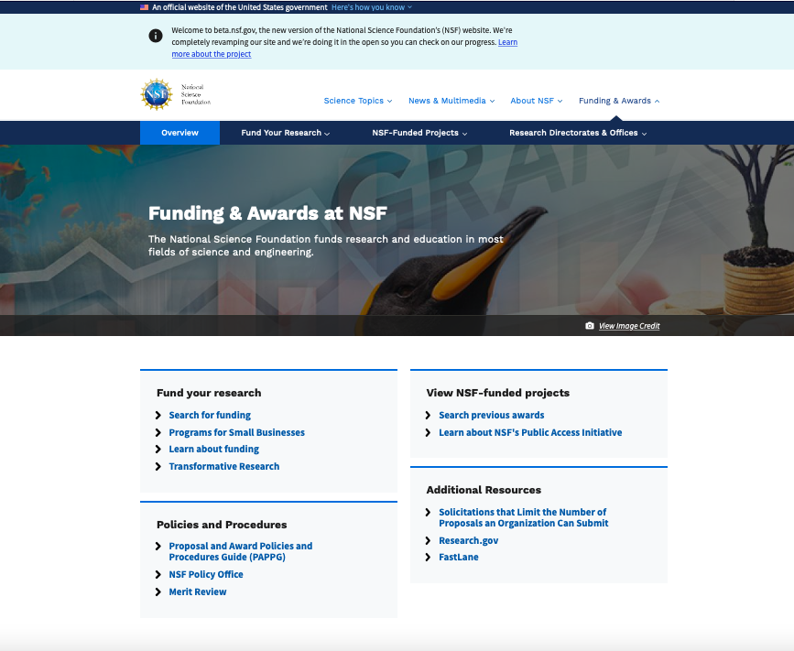

Slide 26
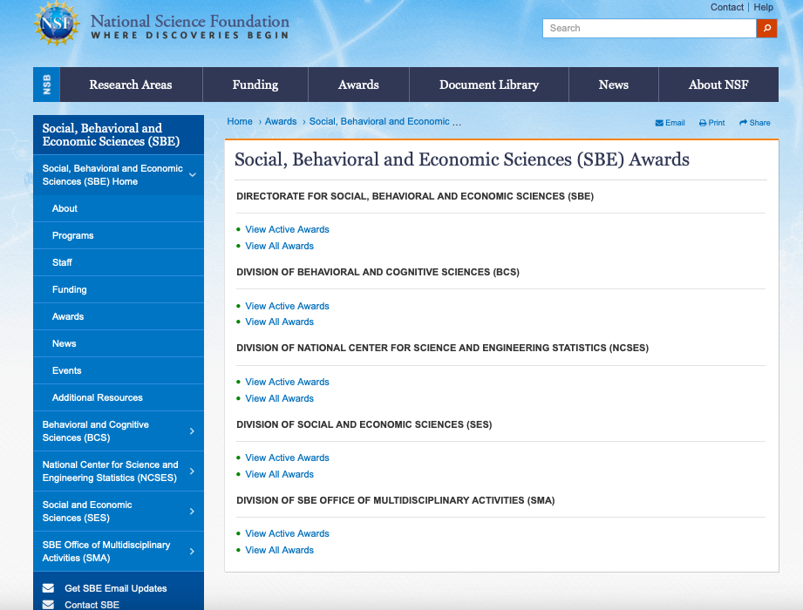

Slide 27
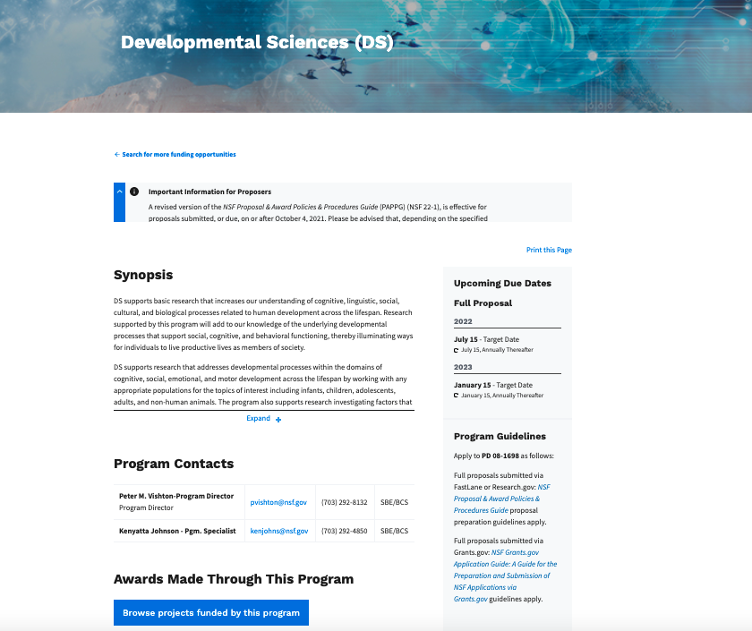

Slide 28
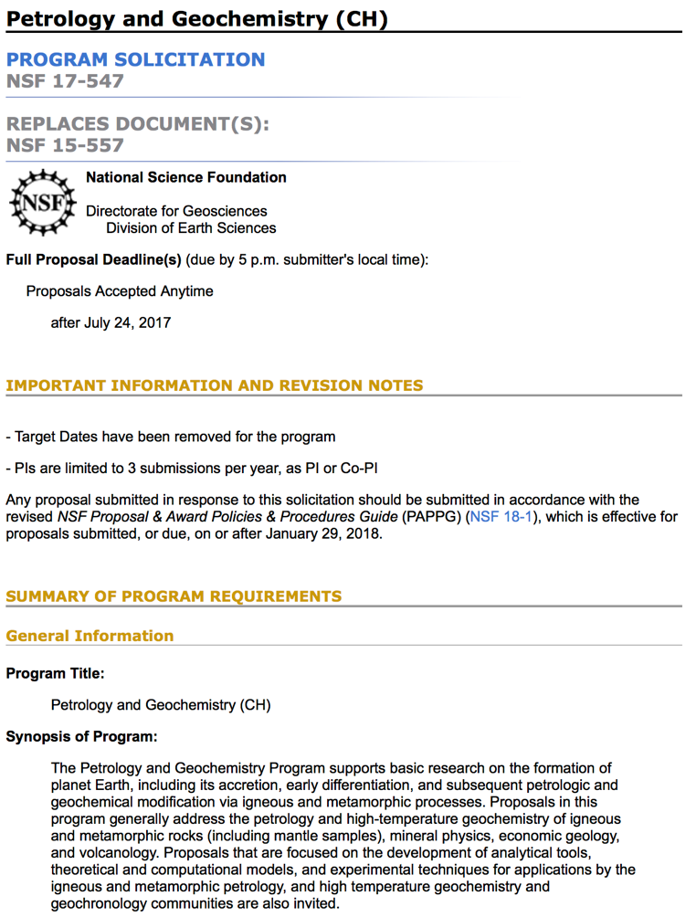
Essential Documents - Solicitation
Deadline / Target Date
Synopsis (do you belong?)
Program Directors (who to ask questions)
Eligibility (are you/your institution allowed in this program?)
Budget limitations
Do you need a Pre-Proposal or Letter of Intent?
How much money do they have, how many awards do they expect?

Slide 29
How does NSF make decisions about which proposals to fund?
The Merit Review Process using the Merit Review Criteria

Slide 30
Merit Review Timeline
PI communicates with Program Director to determine program fit
Proposal is Submitted
Program Director reads proposals, identifies reviewers, assembles panels
Reviewers perform 6-8 proposal reviews
Panels convene to discuss and rank proposals
months
-1 0 1 2 3 4 5 6
Program director recommends proposals for funding
Recommendation goes through the approval process
PIs are notified

Slide 31
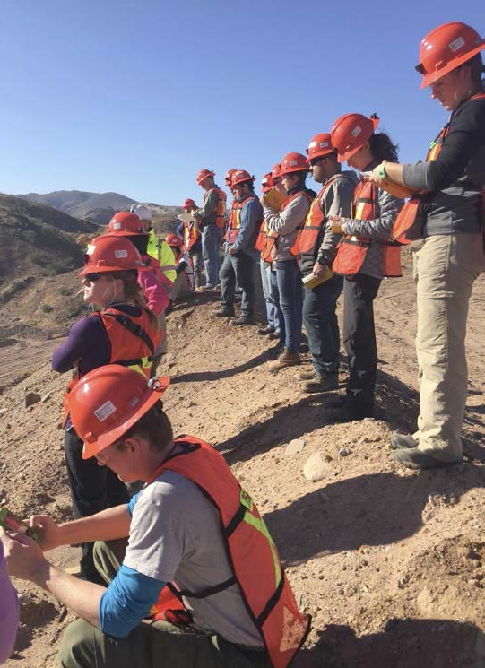
Merit Review Criteria
Intellectual Merit (IM): the potential to advance knowledge
Broader Impacts (BI): the potential to benefit society and contribute to the achievement of specific, desired societal outcomes
More information on Merit Review: https://www.nsf.gov/bfa/dias/policy/merit_review/
Notes:
Intellectual Merit: This criterion encompasses the potential to advance knowledge; and
Broader Impacts: This criterion encompasses the potential to benefit society and contribute to the achievement of specific, desired societal outcomes.

Slide 32
What are the five Review Elements?
IM
BI
Will the work advance knowledge, and benefit society?
Is the work creative? even potentially transformative?
Does the work plan make sense? Will they know if they’re successful?
Is the team qualified to do what they propose?
Do they have the right lab, or know the right people?
Notes:
Reviewers are asked to evaluate your proposal using the MR elementsa.
Structure your proposal to address these 5 Review Elements.

Slide 33
Broader Impacts: Benefitting Society
Teaching, training, and learning (under/grads, local communities, others)
Broaden participation of underrepresented groups
Build or enhance partnerships
Broad dissemination to enhance scientific
+ technological
understanding
Enhance infrastructure (labs, equipment)
Local impacts
(policies @ state + local level)
Notes:
Curriculum; students; REU; teachers; K-12; RET; mentoring; postdoc
Community college; HBCU; minority; Native Americans
with industry, internationally, with other federal agencies, etc.
International collaboration in developing countries; equipment; laboratories, citizen science
Note: THIS IS NOT A CHECKLIST!
Hazards; policy; environmental impacts; local + state agencies

Slide 34
Broader Impacts Framework
(1) How might new and innovative channels of dissemination reach a broader audience? Consider different forms of communicative products.
(2) Who will your research empower? Think of the potential for human capital investment. How will your research help the disenfranchised?
(3) How will your research improve the quality of life in the U.S.? Consider how improvement can result from empowerment.
Notes:
(1) Variety of Communicative Products. Traditional formats such as presentations at conference, and articles and books remain important BIs, PIs should actively think about reaching audiences beyond the academy e.g. lay audiences; user groups; policy and consider formats that are more likely to reach these groups and to resonate with them. PIs are also encouraged to consider newer and more innovative means of communicating the results of their research such as videos, whitepapers, podcasts, and alternative and novel channels and ways of dissemination.
(2) Consider the Empowerment that Results from Communicative Products. Who will your research empower? The obvious groups are students, early career investigators, other academics, but PIs need to think about more creatively about identifying who else might benefit from the research and then ideally connect to the communicative products to these groups (if relevant). Human capital development. Policy. Disenfranchised people.
(3) Quality of Life Improvement that Results from Empowerment. PIs are strongly encouraged to consider how their research might empower, transform, or improve the quality of life for all Americans. PIs need to consider specifically how their work could benefit US society, realizing that basic research may take time to be applied. Investigators conducting research in international locations and with foreign collaborators need to justify their research and think about potential local and US quality of life improvements.

Slide 35
Recommendation Process
Written reviews by ad hoc reviewers and panelists – Overall rating: Excellent, Very Good, Good, Fair, Poor
Advisory Panel – Recommendation on Competitiveness for Funding
“Bin” Approach to Recommendations (3-5)
Program Officers Make Final Decisions - Portfolio Balance Approach
Competitive
Highly
Competitive
Not Competitive

Slide 36
Factors POs Consider to Balance the Portfolio:
Support for high-risk proposals with potential for transformative advances
Different approaches to significant research and education questions
Capacity-building in a new and promising research area
Potential impact on human resources and infrastructure
NSF core strategies, such as: (1) the integration of research and education and (2) broadening participation
Achievement of special program objectives and initiatives
Other available funding resources
Geographic distribution

Slide 37
Why Proposals Are Declined
Failure to establish a sound theoretical framework and/or poorly related to relevant literature.
Flawed research design OR failure to specify research methods in sufficient detail. Often, plans for data analysis are insufficient.
Sound theoretical framework, solid methodology, but they don’t align with each other.

Slide 38
Other Reasons for Declines
Failure to respond to solicitation
Failure to follow directions
The project is too focused on a specific case
Project is “too applied”
Anticipated contribution incremental
Bad Luck
Remember, it is useful to submit, even if declined…
Revise and resubmit
Discover other funding sources
Forces thinking
Builds relationships
Receive reviews from experts

Slide 39
To Revise a Proposal or Not?
Principal Investigators submit on average about 2.3 proposals for every award they receive.
NSF funds about 20% of proposals, despite deeming 30% of proposals worthy of funding.
Two types of Not Competitive proposals:
Poor quality proposals (lots of Fair or Poor ratings)
Great ideas but not yet ready – usually because of methodological flaws
Competitive or Medium/Low Competitive
Solid proposal but not the most innovative
Some flaws but not fatal – fundable but not at top

Slide 40
Advice for Contacting a Program Officer
Email first - DON’T cold call
Send a 1-2-page project prospectus.
Ask for feedback on relevance for program, not substance of project.
Read all information available online first – DON’T ask questions for information that is readily available on the program or agency website.
For co-review by 2 or more programs, contact all relevant POs in a single message.

Slide 41
Questions?

Slide 42
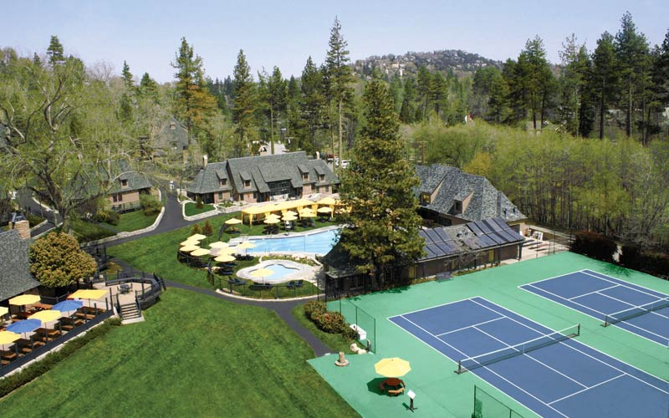
Networking for Collaboration
Notes:
LP

Slide 43
Networking Breakout Prompts
1. Introduce yourselves
Brief Description of Your Research Interests
What was the worst job you ever had?
2. OTHER Prompts for Discussion
How can CAHSSA networking support your research goals?
Are you looking for a collaborator?
What is your experience with collaboration?
Notes:
LP

Slide 44
Future Webinars
Anatomy of a Winning Proposal
March 17, 2022, 12:00 – 2:00
Developing Grant Budgets & Data Management Plans
April 22, 2022, 10:00 – 12:00
Describing Social Science Methods in Proposals
May 19, 2022, 12:00 – 2:00
REGISTER HERE: https://cahssa.ucsb.edu/programs/
Notes:
LP

Slide 45
Post-Webinar Evaluation
Please take a couple of minutes and complete a quick feedback evaluation survey. Link in Chat.

Slide 46
THANK YOU!
NSF Resources:
a. Proposal & Award Policies & Procedures Guide (PAPPG)
Current: NSF 22-01 https://www.nsf.gov/pubs/policydocs/pappg22_1/index.jsp
b. Specific Program Descriptions and Solicitations
c. Agency Outreach Events – see: https://nsfpolicyoutreach.com
d. Funding alerts - https://service.govdelivery.com/accounts/USNSF/subscriber/new
e. SBE Directorate - https://www.nsf.gov/dir/index.jsp?org=SBE
f. EHR Directorate - https://www.nsf.gov/dir/index.jsp?org=EHR
Other Links:
CAHSSA Faculty Research Survey https://csuci.qualtrics.com/jfe/form/SV_a5KFY1RWSTJLZK6
Federal Grants Info - www.Grants.gov
Philanthropy News Digest - https://philanthropynewsdigest.org
CAHSSA webinars - https://cahssa.ucsb.edu/programs/
Notes:
LP
Take survey!

